Slide 1
Digital Commerce BlueBolt Hackathon - 2024
Team Name :
CommerceCode

Slide 2

Idea Leverage proprietary software to assess product carbon footprint, enable offsetting, plant trees, and empower resource trading for environmental sustainability.

Slide 3

Business Scenario
Precision Tracking: Develop software for precise measurement of product carbon footprints.
Seamless Offset Integration: Integrate carbon offsetting into the purchase process for customers.
Direct Environmental Action: Implement initiatives like tree planting to mitigate environmental impact.
Marketplace Creation: Establish a platform for trading environmental contributions.
Transparent Reporting: Provide clear and honest reporting on environmental impact.

Slide 4
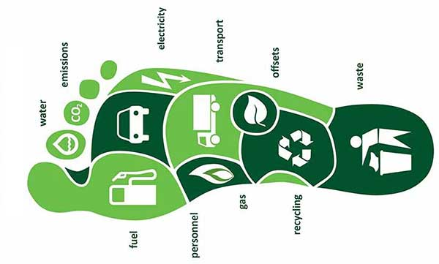
Carbon Footprint Calculator
Carbon Footprint Calculator on PDP
Inputting parameters such as fuel used for product manufacturing
Significant impact on sustainability while enhancing the customer experience

Slide 5

Integration and Future Considerations
Integration with Checkout Cart & Future Considerations
Reflect the carbon footprint cost
Customization options for the calculator parameters
Encourage eco-friendly shopping habits

Slide 6
Database Integration
Product Database : A Comprehensive database of various products and their associated raw materials used and energy consumed during the production process.
Industry Specific Customization
Regular Monitoring

Slide 7
USP's of Our Product
Analytics and Reporting : Provide users with detailed analytics and reports on their environmental impact, including carbon emissions reduced, trees planted, and resource trading activities.
User Engagement and Education : Incorporate features to educate users about the importance of sustainability and provide tips on how they can further reduce their environmental footprint.

Slide 8

Solution Approach/Critical Features​
Initiative that combines environmental sustainability with financial opportunity
Sapling Initiative
Trading and Encashment Platform

Slide 9

Solution Approach/Critical Features​
Sapling Initiative
Tie up with third Party Sapling Planting Company
Expertise
Collaboration
Real –Time Monitoring
Transparency

Slide 10
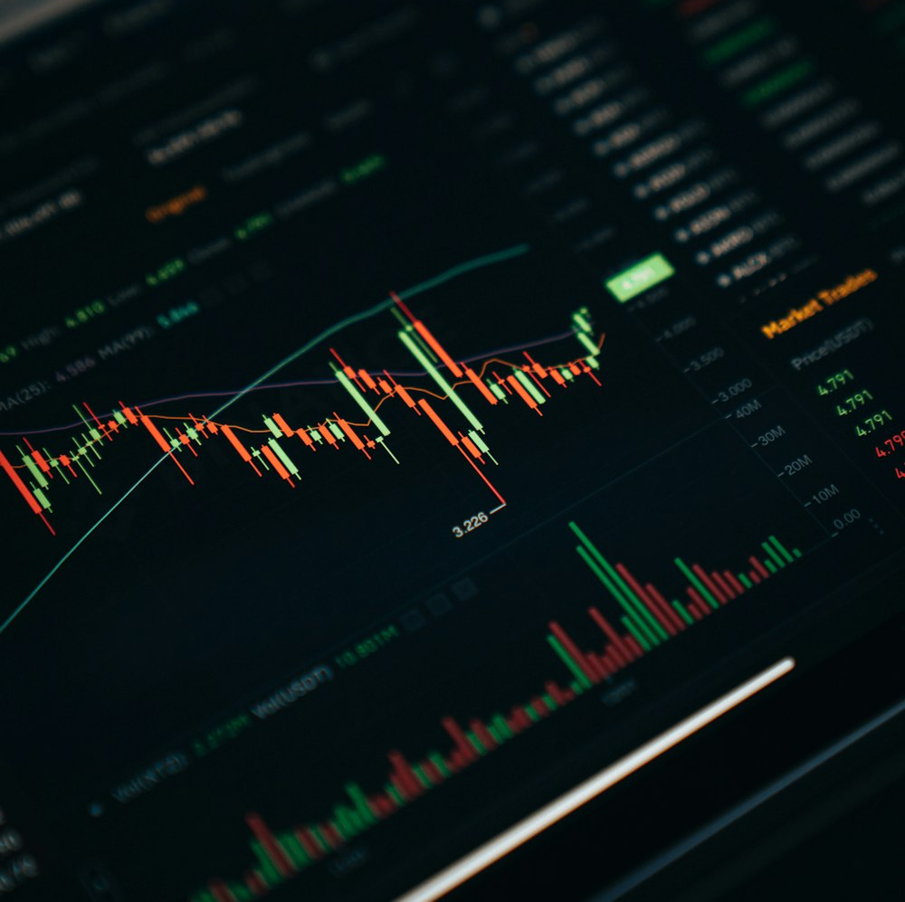
Solution Approach/Critical Features​
Trading and Encashment Platform / Platform Development
Exchange
Broker
Market Data Aggregation
Market Data Integration
Liquidity

Slide 11
Innovativeness/ Uniqueness:-
Precision Carbon Tracking
Seamless Offset Integration
Direct Environmental Action
Market-Driven Sustainability
Comprehensive Engagement
Transparent Accountability
Scalable Global Impact

Slide 12
Opportunity:
Harness the increasing consumer interest in sustainability by providing them with accessible tools to understand and mitigate their carbon footprint, while also offering businesses innovative solutions to implement transparent sustainability practices.

Slide 13
Estimated Benefits with Beneficiary
Environmental Impact Reduction - Planet, Wildlife, Future Generations
Climate Change Mitigation: - Global Population, Vulnerable Communities
Biodiversity Conservation - Endangered Species, Biodiverse Habitats
Consumer Empowerment - Consumers, Communities
Corporate Reputation Enhancement - Businesses, Shareholders

Slide 14
Thank you

